Slide 1
Liking and Loving
5th Grade S.H.A.R.e.

Slide 2
3 Types of Self Love
Mental
Physical
Emotional

Slide 3
Video: The Reflection in Me

Slide 4
No One Is You… That’s Your Super Power
unknown

Slide 5
LIKE LOVE

Slide 7
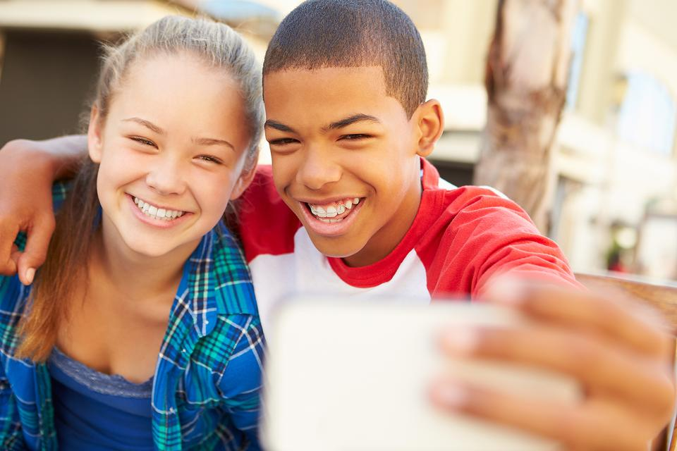

Slide 9
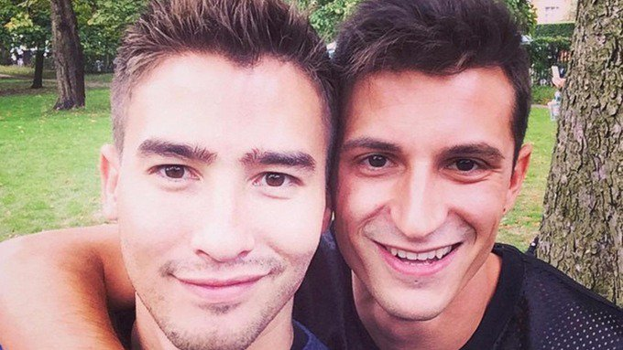

Slide 10
Video: Another Pep Talk from Kid President to You

Slide 11
Who can you talk to?
Parent or Guardian
Trusted adult
School Counselor
School Nurse
Teacher
Faith based leader
Health Clinic
Health care provider

